Slide 1

Q2 2025

Slide 2
REPORT CONTENTS
Financial Dashboard
Building People, Processes and Outreach
Q2 Event Highlights
What’s Next?

Slide 3
Financial dashboard: donations​
Month(s) | 2023​ | 2024 | 2025
April | 164 | 222 | 185
May | 174 | 260 | 492
June | 249 | 275 | 392
Q2 TOTALS | 587 | 757 | 1069
Jan-June | 1046 | 1321 | 1784
Everything starts with DONATIONS and this year we are seeing a huge increase month over month in incoming donations (except April due to freezing weather conditions).
We anticipate this trend to continue due to an ongoing effort of expanding community awareness through new branding, marketing and blessing events.
More customers are finding us and sharing with their friends and family! When we share “who we are” at the donation's door, our customers feel blessed about where their donations are going!

Slide 4
Financial dashboard: SALES
We have seen a steady increase in customers in general and of NEW customers*!​
TOTAL CUSTOMERS 2024: 1086
TOTAL CUSTOMERS 2025: 1703
TOTAL NEW CUSTOMERS 2024: 256
TOTAL NEW CUSTOMERS 2025: 449

Slide 5
Financial dashboard: SALES
Q2 Sales Breakdown by Hour and Item Type:
Clothing is almost 40% of overall sales.
Early Sales / Extended Hours has not been a customer draw.
Busiest points are still mid-day and Fridays.

Slide 6

BUILDING: PEOPLE
Team Development –
  Assistant Director (Warehouse/Middlestore): OPEN
Spiritual Development –
  Increased focus on practicing Prayer.
  Offering Devotionals at Monthly Team Meeting and Bible Studies to anyone who might be interested.
Professional Development
  Job descriptions completed for all staff and volunteers
  StandOut Assessments

Slide 7
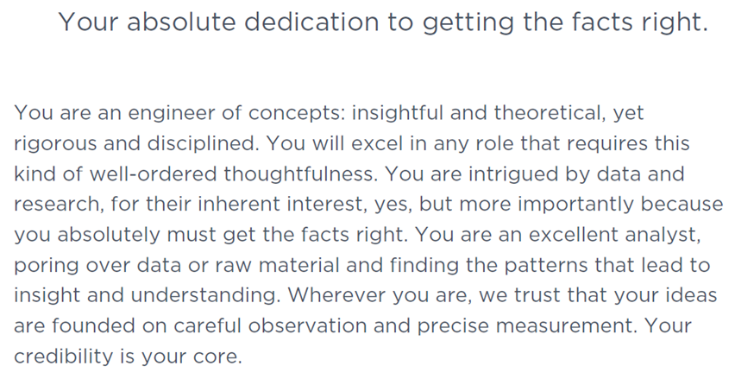
BUILDING: PEOPLE
Purpose of StandOut Assessments –
  To discover the natural skills and talents of our staff and volunteers as God created them
  To see how those skills and talents work together to compliment one another and support the organization
  To give us insight as to how to utilize and develop those gifts to bring God more glory
Cindy Farrington’s StandOut Summary:

Slide 8
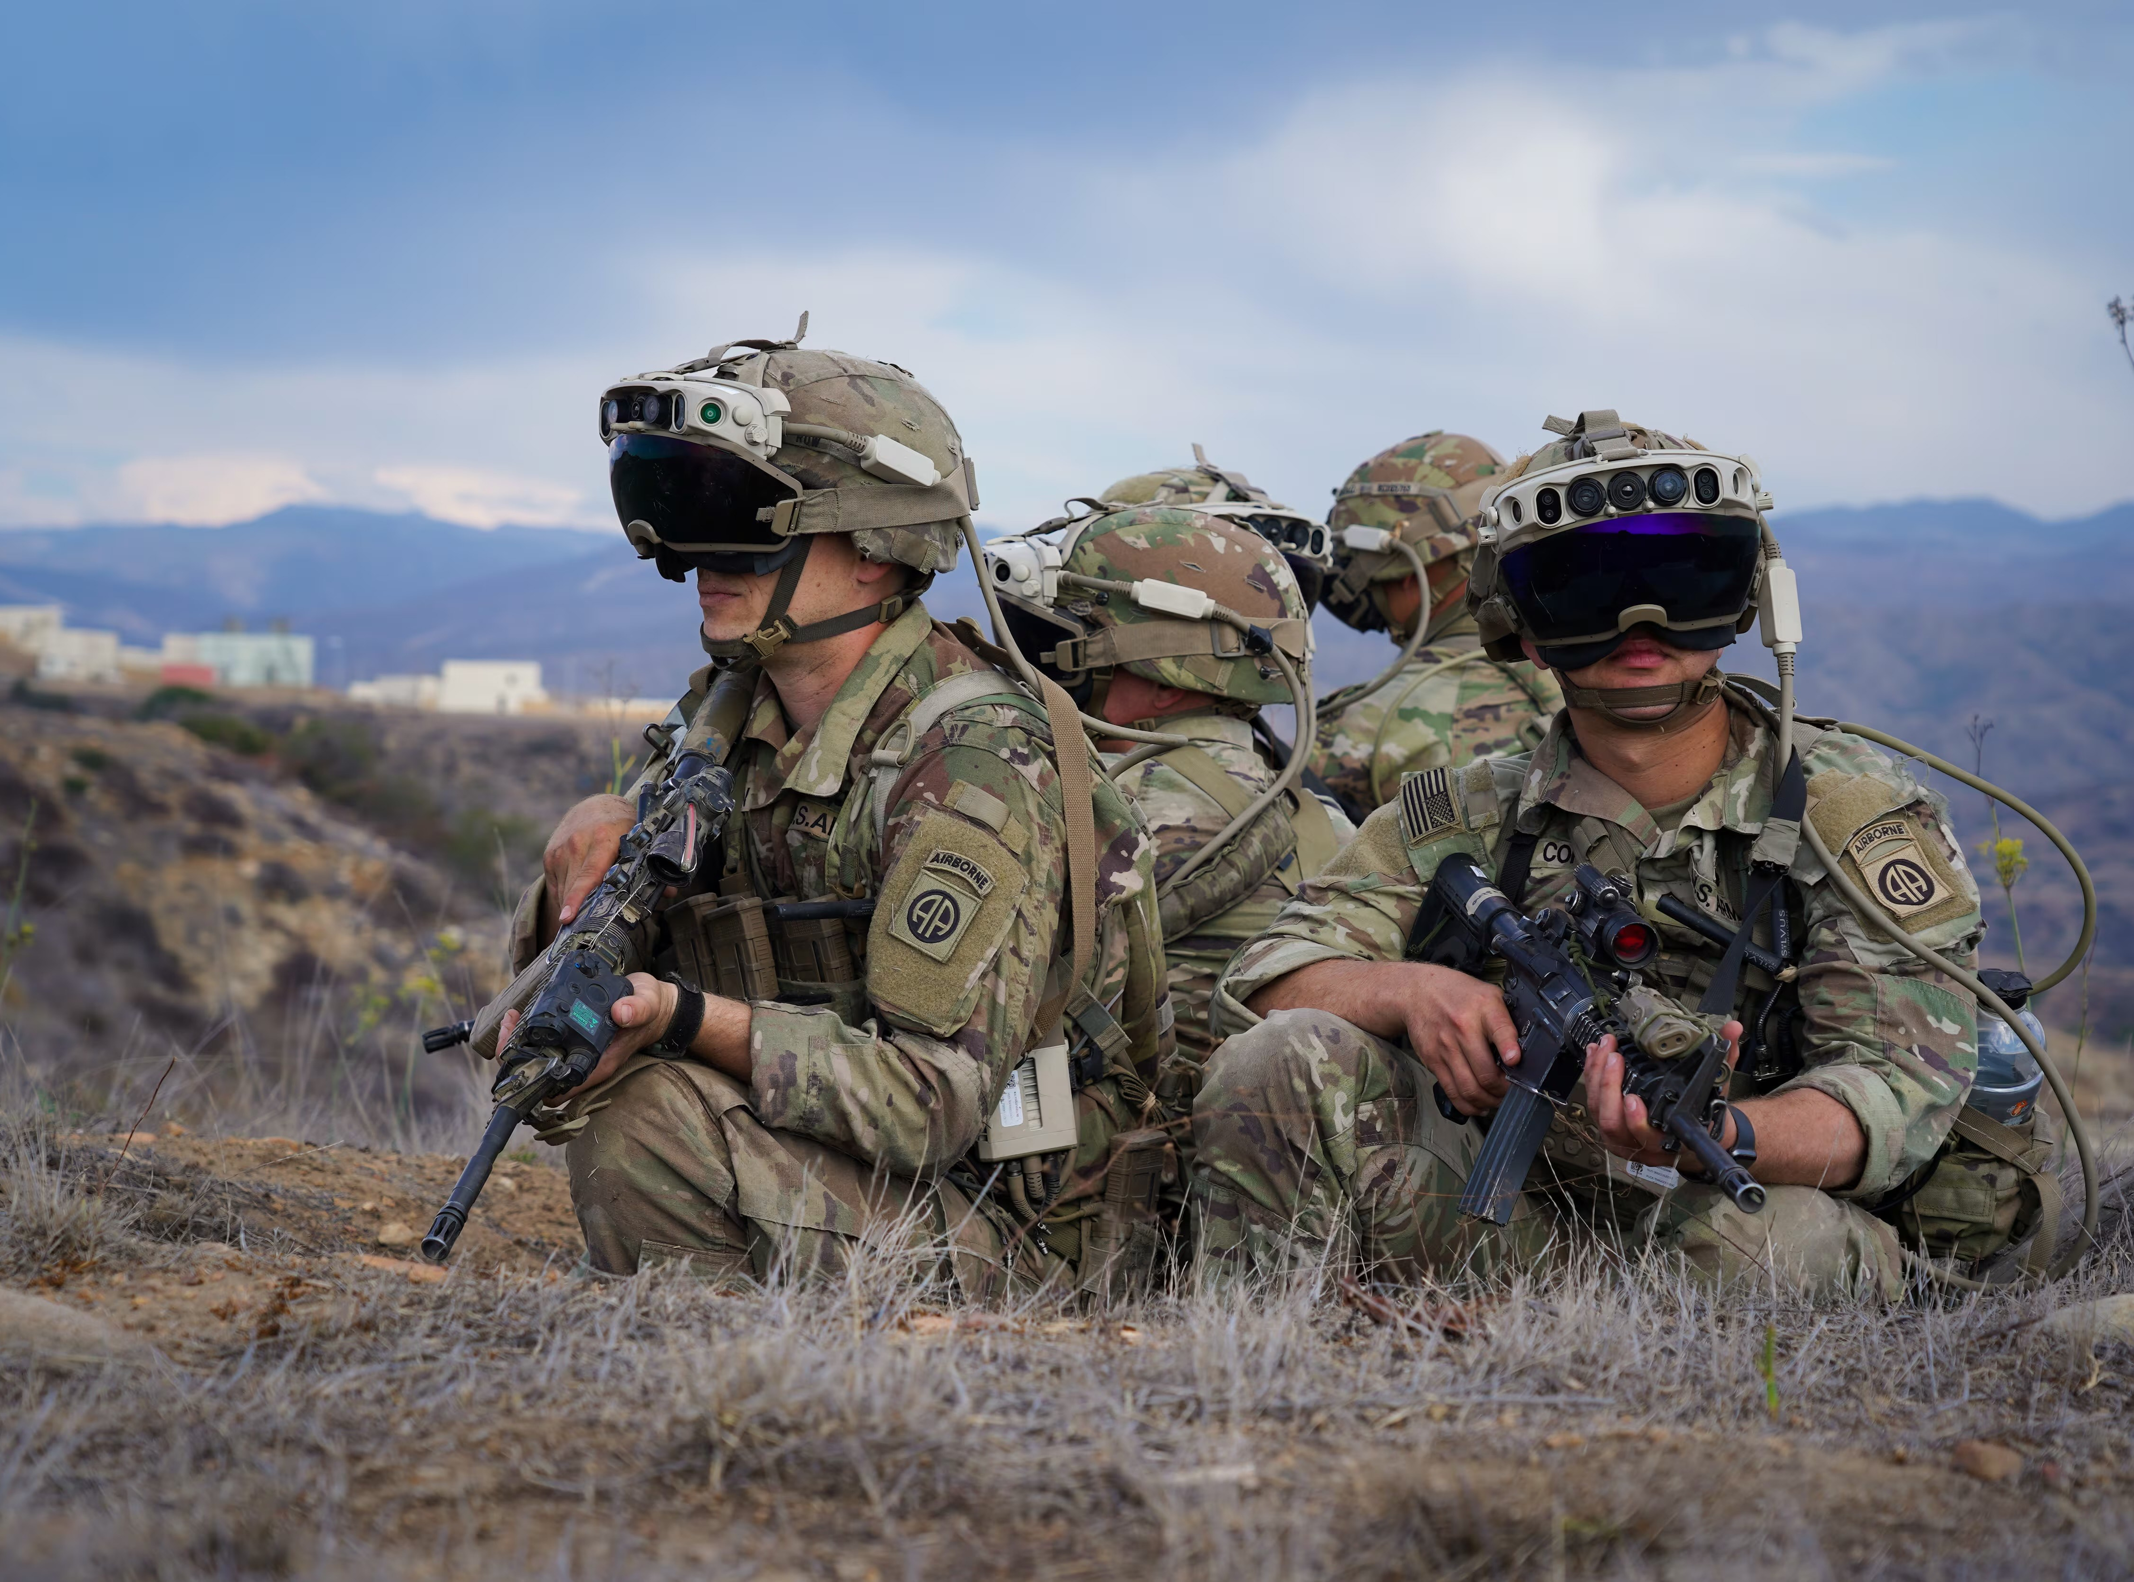
BUILDING: PROCESSES
Spring Refresh -
  Continuing to standardize systems for design/policies.
TAC Team Huddles -
  Team Time
    Spending a few moments together to check in, laugh, encourage, pray – whatever is needed because ministry is a team sport. We need to be in one accord, lifting each other up.
  Assignments
    Determine which projects are priority and who’s doing what
  Communication
    Communicate expectations, relay important updates, staffing details, etc.

Slide 9
BUILDING: OUTREACH
Digital Ministry – Sharing “Who We Are”
  Origins Series
  Other Marketing Methods & Future Plans
Media Blitz Events & NEW BRANDING!
  Appanoose Weekly Article
  GoPitchTV Video Interview and Commercials
  Ribbon Cutting and Grand Re-Opening Event

Slide 10
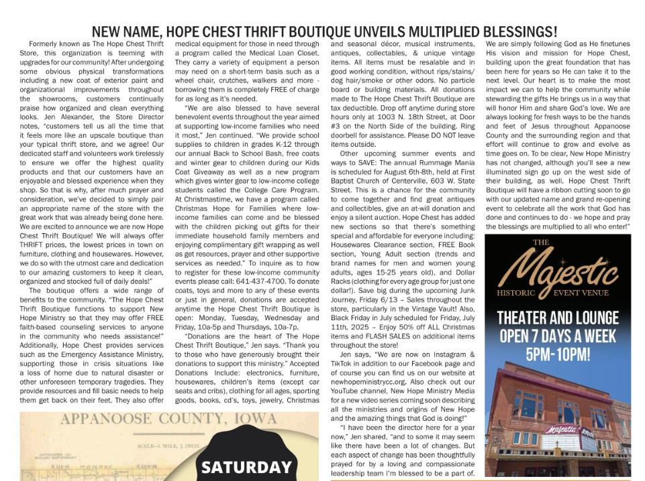

Announcement of NEW NAME in Appanoose Weekly Article:
Published June, 2025

Slide 11


Ribbon Cutting / Grand Reopening Event
Published by
GoPitchTV
Attended by New Hope Ministry Staff and Volunteers, PACT Representatives and GoPitchTV.

Slide 12
Event HIGHLIGHTs –
Q2 SALES EVENTS:
Prom Sale
Made for Mom Baskets
Before Business Hours
Junk Journey
Memorial Day - Closed
UPCOMING EVENTS FOR Q3:
Black Friday in July
Back to School BASH! (prep for Christmas)
Labor Day

Slide 13

What’s next?
We will continue to build structure and clarity, refining efficiencies and working in one accord with New Hope’s mission.
We will look after one another humbly, seeking ways to outdo one another in good deeds.
We will steward His gifts graciously and generously and with His daily guidance to bring Him the most glory.
We will stay open to the Holy Spirit’s prompting, being willing to adjust “our” plans and be transformed by His mighty work in our lives and in this ministry.
We will continue to seek The Lord in everything we do, daily asking how we may serve Him and share His love with others.

Slide 14
THANK YOU
Jen Alexander
hopechestdirector@gmail.com​

